Slide 1

Bellabeat Case Study
Google Data Analytics Capstone Project
Author: Qanitah Nizam
Last Updated: 20-11-22

Slide 2
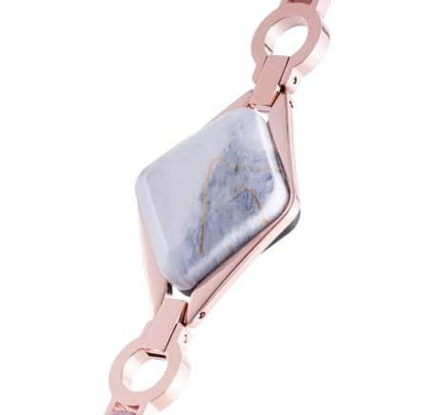
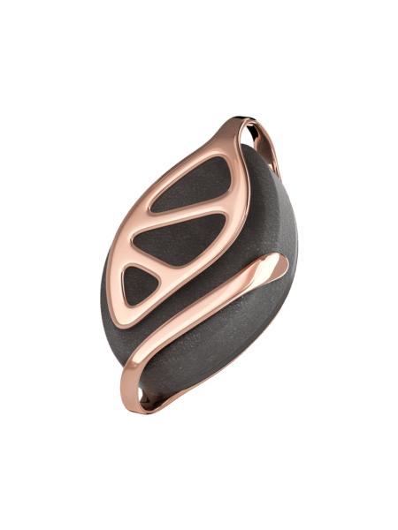
Project Background
High-tech Smart device company
Focused on women
Products:
Ivy - monitors heart rate, cardiac coherence, respiratory rate, activity, and sleep.
Leaf - tracks activity, sleep, stress, meditation and reproductive health.
Ivy
Leaf

Slide 3
Objective
To grow and become a larger player in the smart device industry.
What are some trends in smart device usage?
How could these trends could apply to bellabeat consumers?
How could these trends help influence bellabeat marketing strategy?
Business Task

Slide 4
DataSet
Data Source: 33 participants FitBit Fitness Tracker Data from Mobius: https://www.kaggle.com/arashnic/fitbit
The dataset has 18 CSV.
Only 30 user data is available. The central limit theorem general rule of n≥30 applies.
FitBit Dataset
daily_activity_merged | 33 users
sleepDay_merged | 24 users
hourlySteps_merged | 8 users

Slide 5
Data Cleaning
Loaded Dataset to R
Split Date & Time into separate columns
Removed duplicate and null values
Corrected data types

Slide 6
Useful Insights

Slide 7
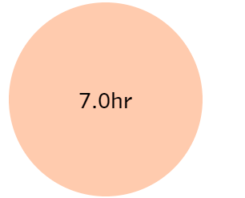
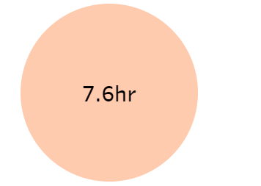
Sleep Analysis
On average a person sleeps 7 hours every day.
Sleep time
On average Bed time per day is 7.6 hours.
Bed time

Slide 8
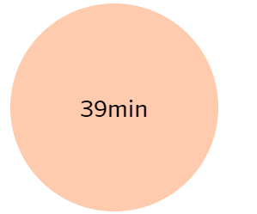
Average Awake Time = Bed Time - Sleep Time

Slide 9
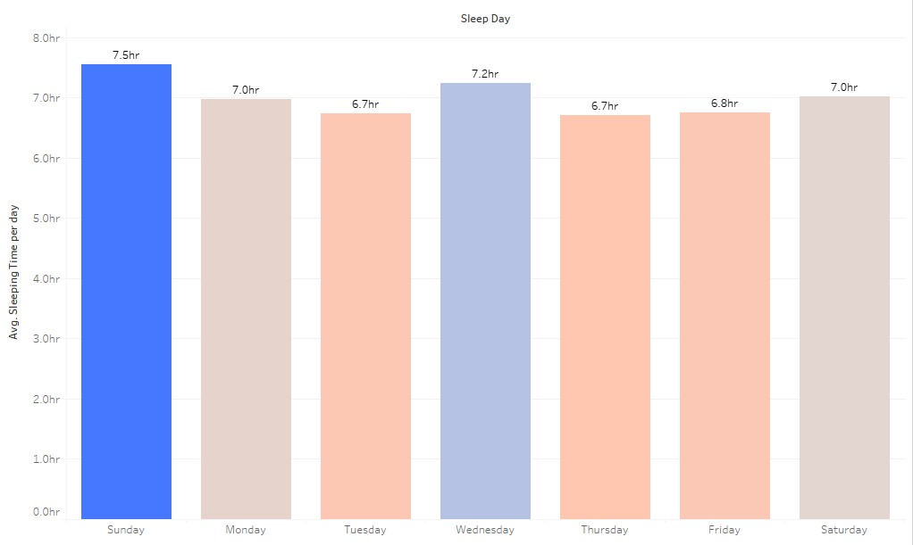
Average Sleeping time day-wise
People sleep most on SUNDAY

Slide 10
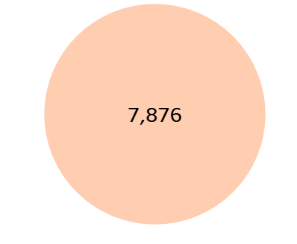
Steps Analysis
On average people take 7,876 Steps Per day.
Daily Steps

Slide 11
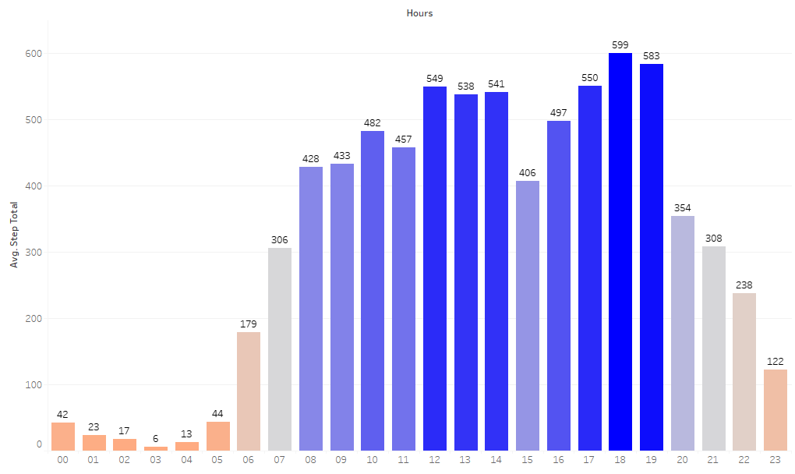
Around 5PM - 7PM people take the most steps

Slide 12
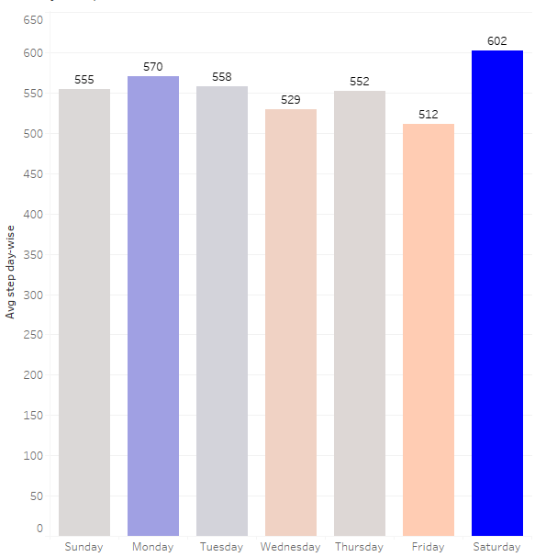
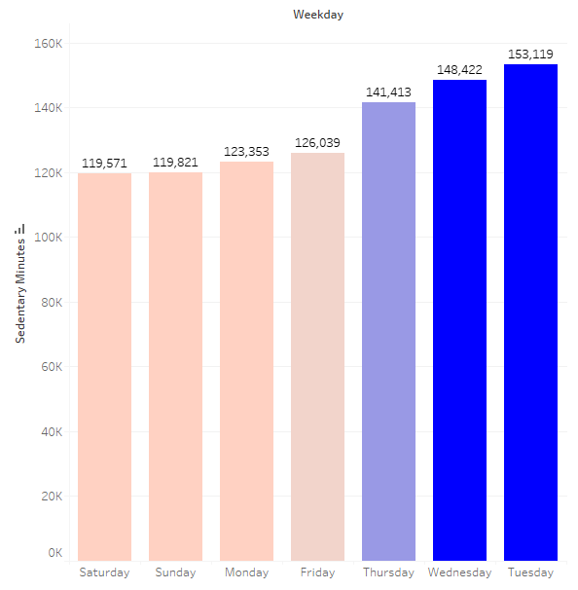
People are OUT & ABOUT on SATURDAY
More Steps on Saturday
Less Sedentary Minutes on Saturday

Slide 13
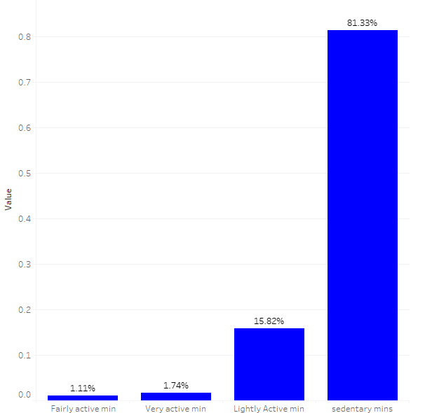
Percentage of Active Mins
Users tend to spend more time being sedentary.
They spend around 15% of their time in lightly active tasks.
Only 1.74% of the user’s time is spend in very active activities such as, workout, running, or swimming.
Remaining 1.11% of the time users are found fairly active.

Slide 14
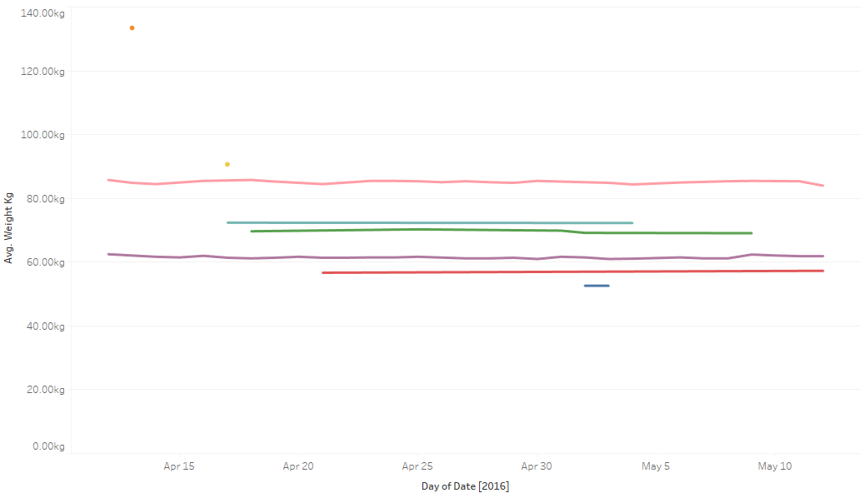
Users Weight Variation throughout the Month

Slide 15
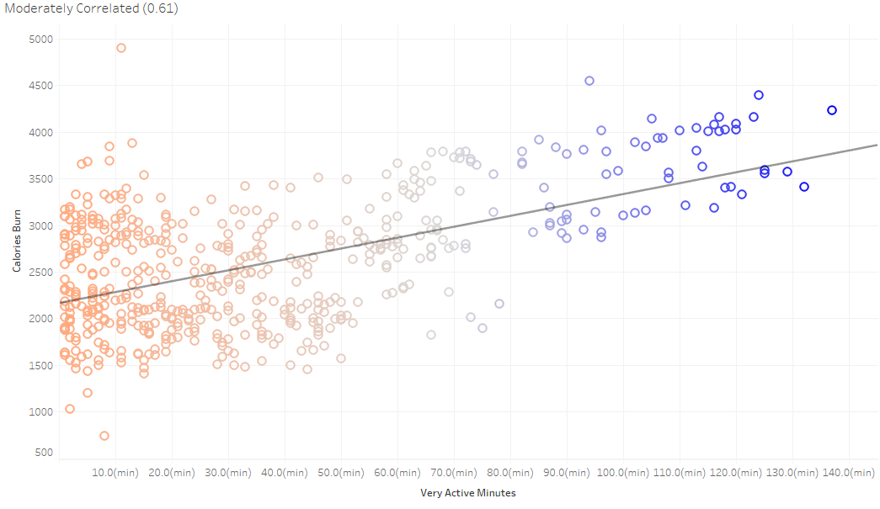
Users who were more active burn more calories

Slide 16
Recommendations

Slide 17
To reduce awake time in bed by 25% remind the user to go to sleep, when awake time in bed exceeds 20 mins.
To increase very active minutes by 15% give a workout alert to the user everyday.
To reach daily steps upto 10K remind users to take a walk every 15 min.
Introducing a concept of leaderboard. It will create enthusiasm among the users to keep meeting their daily health goals.

Slide 18
Thank You

